Slide 1
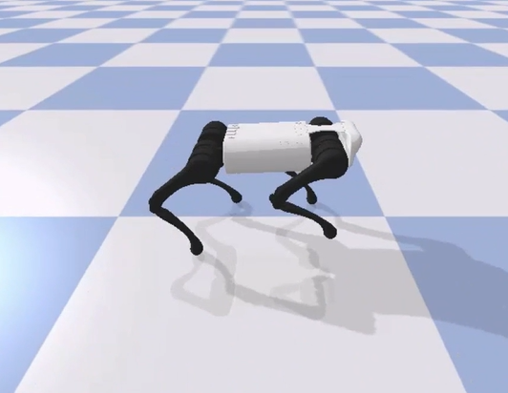
Legged Robots Group 16
Loïc von Deschwanden
Christophe Deloose
Lukas Stuber

Slide 2
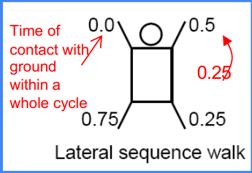
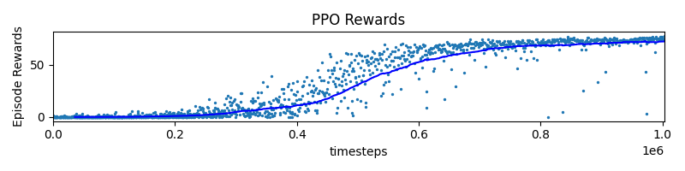
Successful Run
Learning algorithm: PPO
Gait mode: WALK
Motor control mode: CPG
Target velocity: 0.8 m/s
Total distance: 7.8m
Observation space: Default + CPG amplitude and phase
Reward function: default + more weight on distance reward

Slide 3
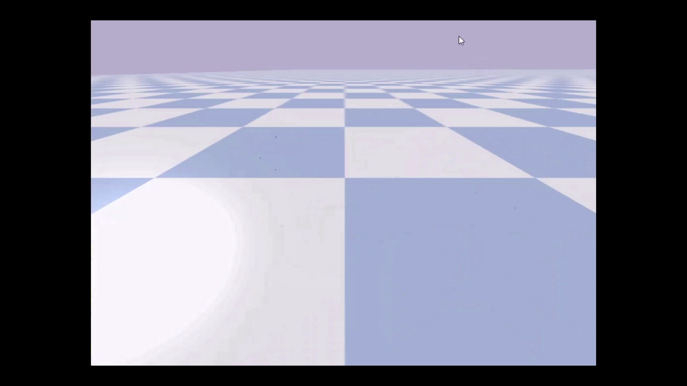
Successful Run

Slide 4
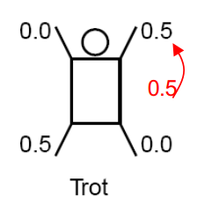
Blooper
Gait mode: TROT
Learning algorithm: SAC
Motor control mode: CPG
Target velocity: -0.3 m/s
Observation space: Default + CPG amplitude and phase + Roll/Pitch/Yaw + Base orientation

Slide 5

Blooper

